Slide 1

Retail Banking System
MFPE (POD - 1) INTCDE22IJ047
Team Members
Harshit LNU (2153660)
Jyoti Agarwal(2153193)
Deeptarko Roy(2153124)
Manish Patle (2153310)
Kamaldeep Singh Dhanjal (2152859)
Mentor : Abin Joseph
Trainer : Krishna Kumar Madella Venkata
Coach : Prema R

Slide 2
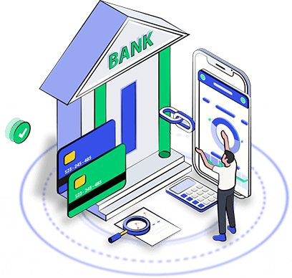
Introduction
The Retail Banking System provides Microservice Architecture based software solution.
It provides high Availability operations for their client & bank employees without disruption.
Different Microservices combines together to perform together as a Uniﬁed application.

Slide 3
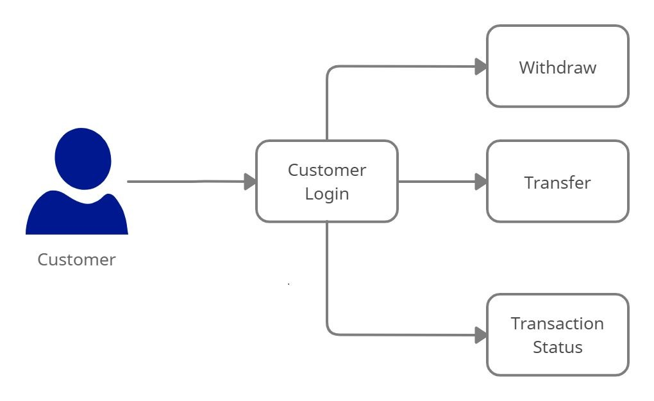
Architecture Diagram for Customer

Slide 4
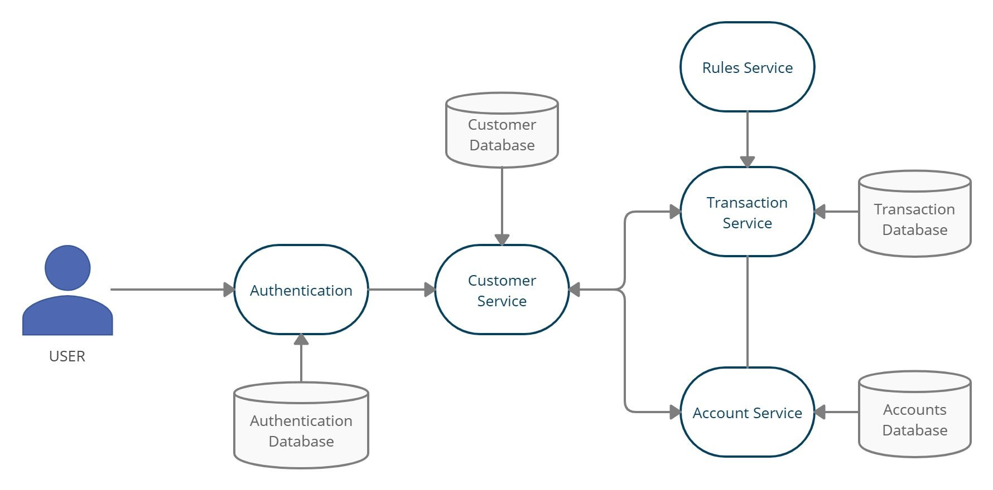
Work Flow :

Slide 5
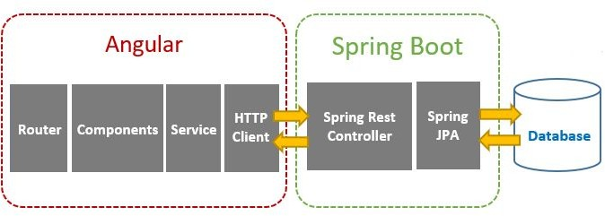
Client – Server Architecture

Slide 6
Technologies Used
Front End : Angular 14
Backend : Java, Spring Boot, Restful-Services
Database : H2 - database
Tools : Spring Tool Suite, Swagger, Postman, AWS, Docker Desktop

Slide 7
Working Microservices:
Authentication microservice
Customer microservice
Account microservice
Transaction microservice
Rules microservice

Slide 8
Authentication Microservice
Authentication Microservice will perform operations like:
Login
Save User
Authentication will provide the JWT token after user’s validation.
Providing the authorization based on user’s login

Slide 9
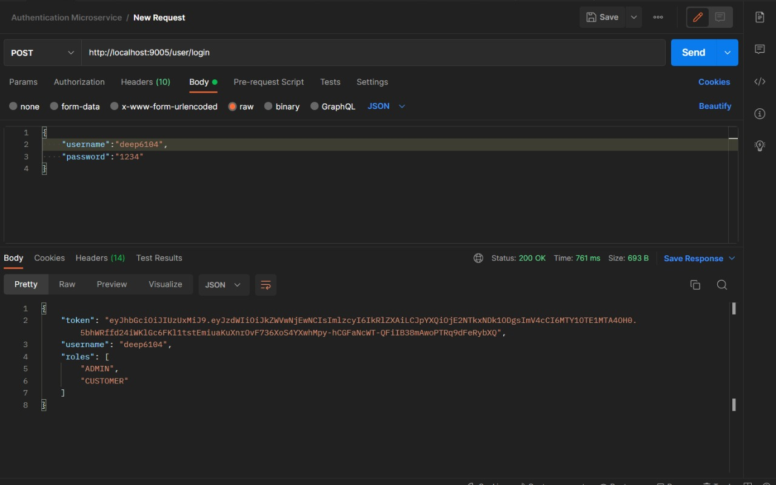
Authentication Microservice - Sample Request

Slide 10
Customer Microservice
Customer microservice will performs operations like :
Creation of Customer
Fetching Customer Details
It even interacts with account microservice for the purpose of sharing details.

Slide 11
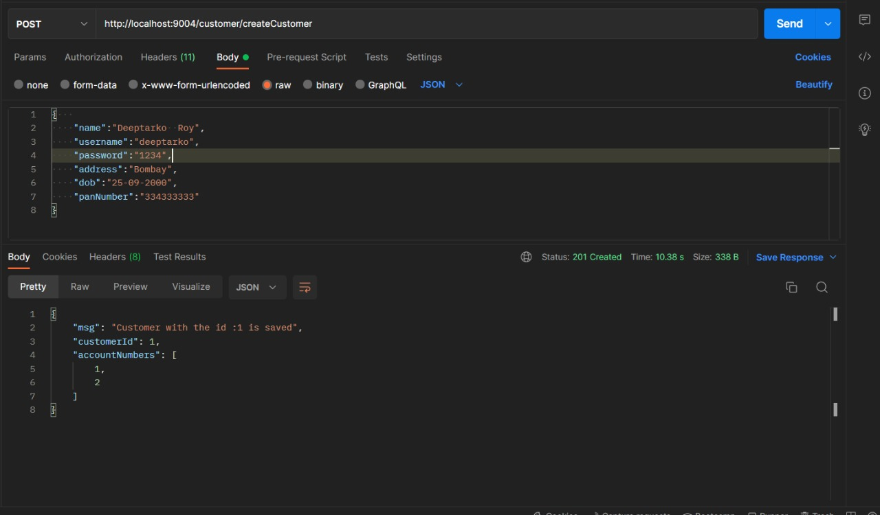
Customer Microservice - Sample request

Slide 12
Account Microservice
Account Microservice will perform following operations:
Customer Account Creation
Fetching Account Details for Each Customer
Deposit and Withdraw from customer’s account.
Interacts with transaction microservice for validating the account details and transferring the amount.

Slide 13
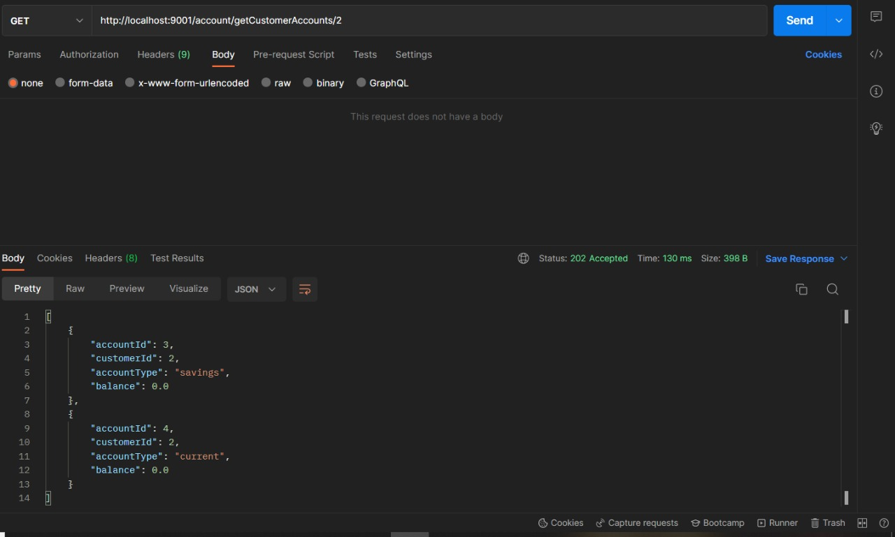
Account Microservice - Sample request

Slide 14
Transaction Microservice
Transaction Microservices will perform operations like:
Fetching transactions history for individual account.
Validating the account details for individual customer.
Checks minimum balance for the transfer and withdraw account.
Transactions microservice will interact with Account microservice to actually complete the transactions within the accounts.

Slide 15
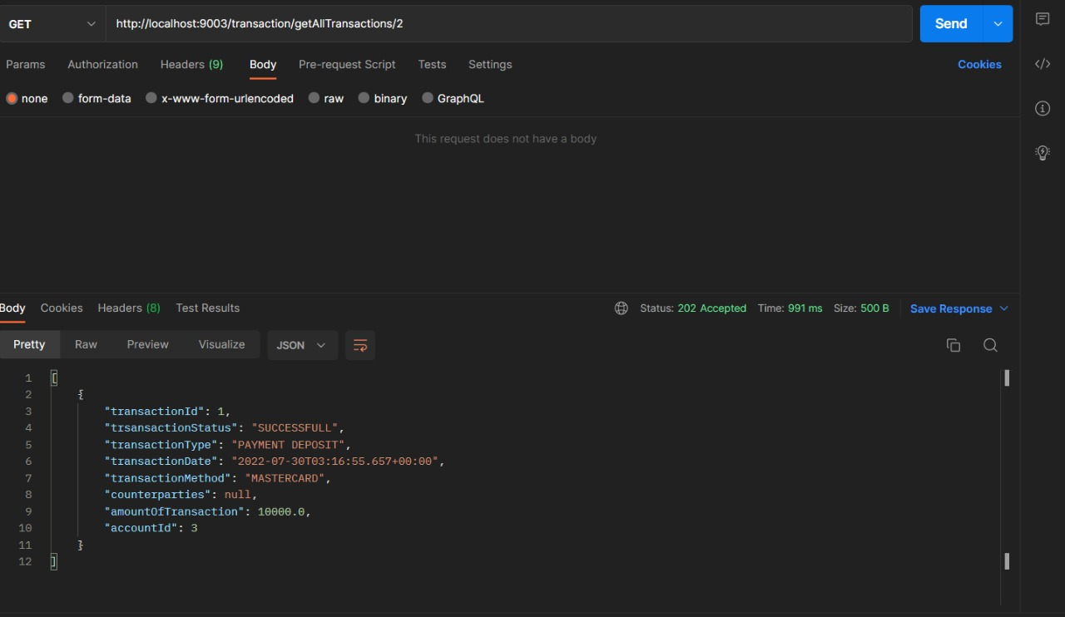
Transaction Microservice - Sample request

Slide 16
Rules Microservice
Rules Microservice will be responsible for evaluating rules:
Minimum Account Balance
Interacts with account and transaction microservice for checking rules while transferring and withdrawing from source account.

Slide 17
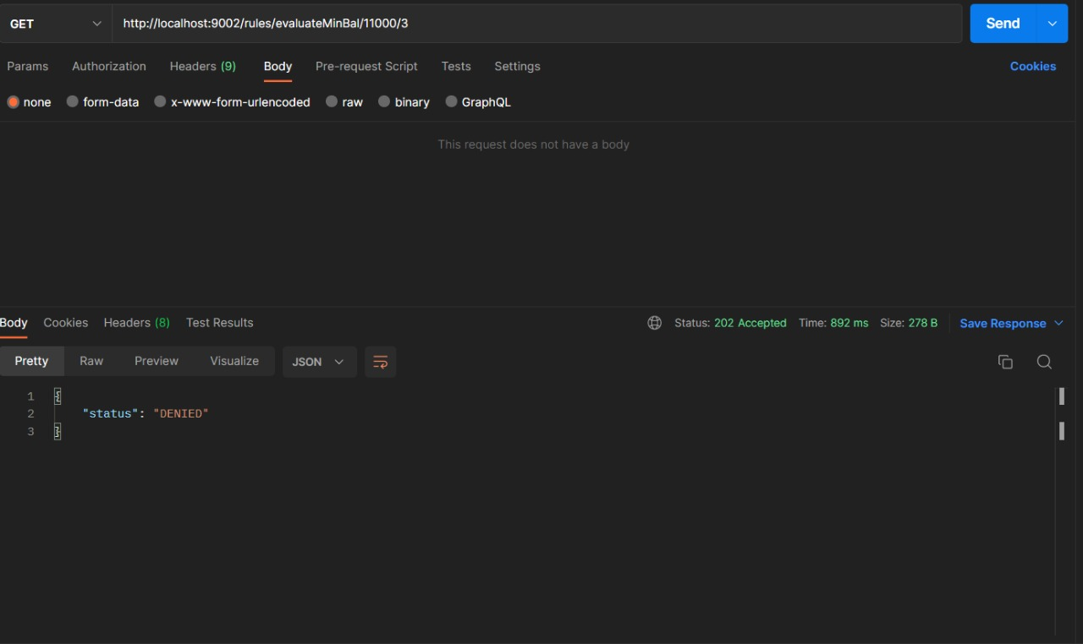
Rules Microservice - Sample request

Slide 18
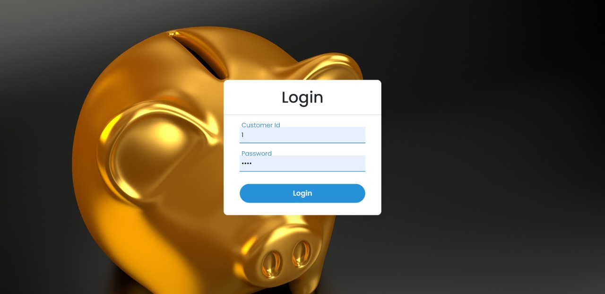
FrontEnd: Angular
This is the UI of the Login Portal.

Slide 19
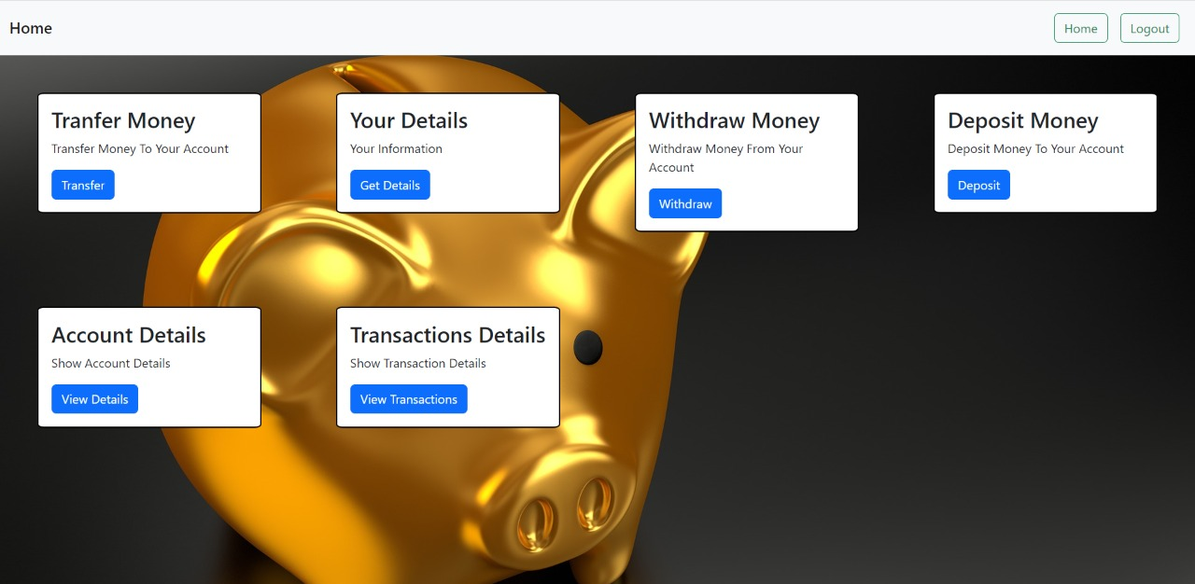
After the Authentication of user is successful it moves to the Home Portal.

Slide 20
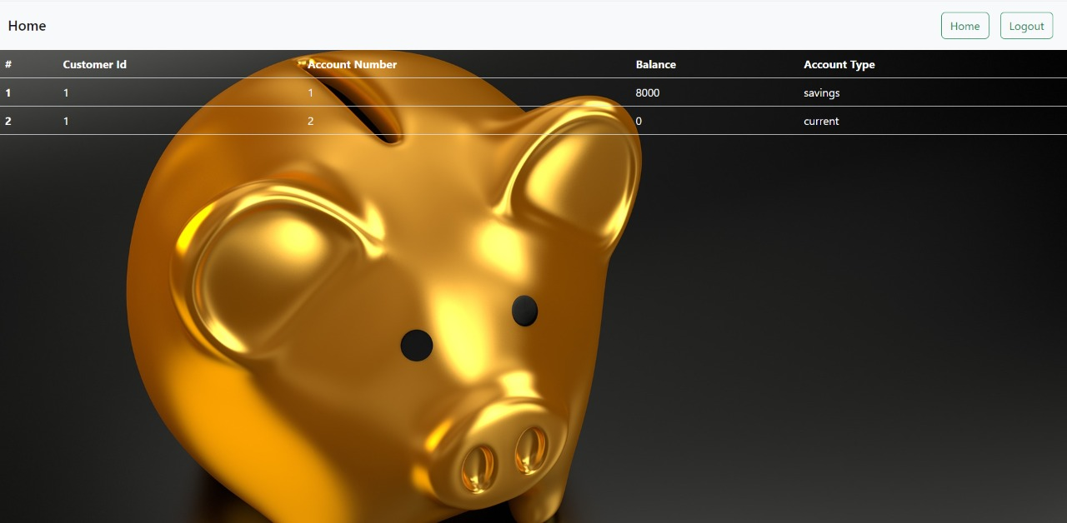
From Home Portal we can access Account Details and perform other operations.

Slide 21
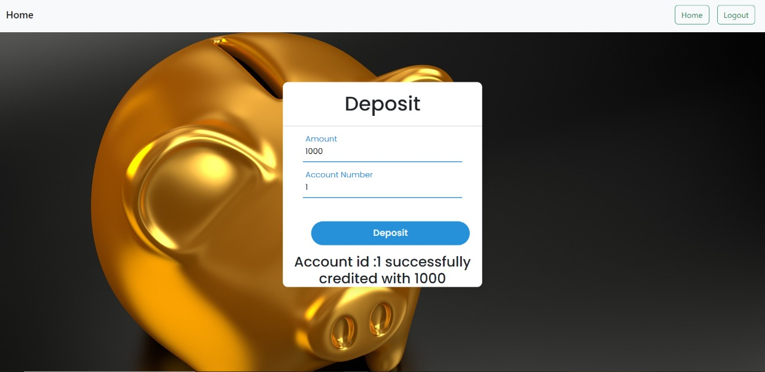
Depositing Money In Account.

Slide 22
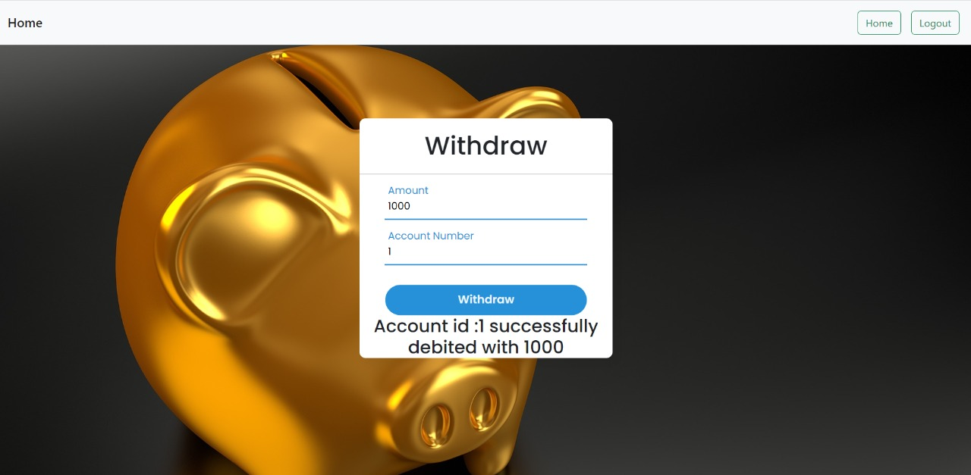
Withdrawing Money from Account.

Slide 23
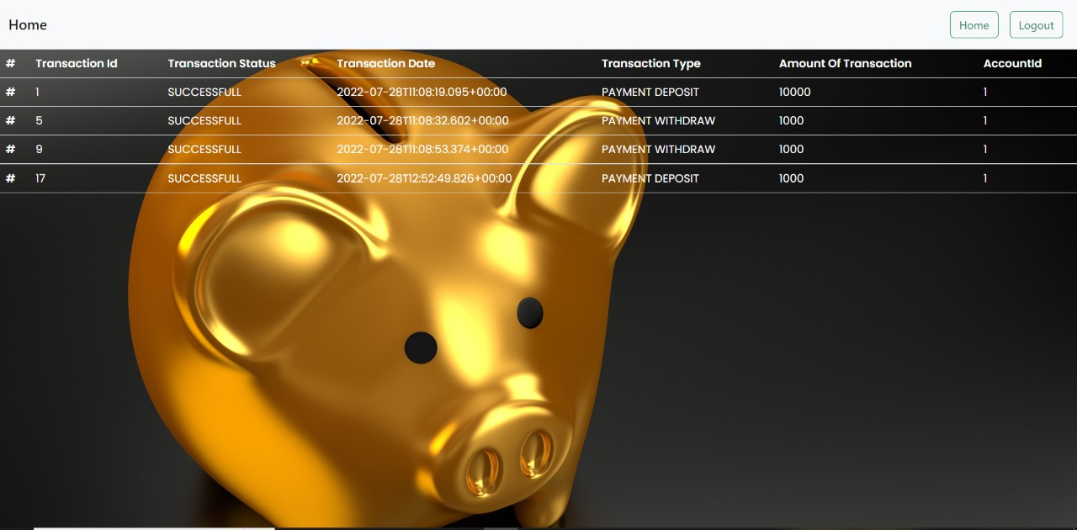
Transaction Details of a Particular Account.

Slide 24
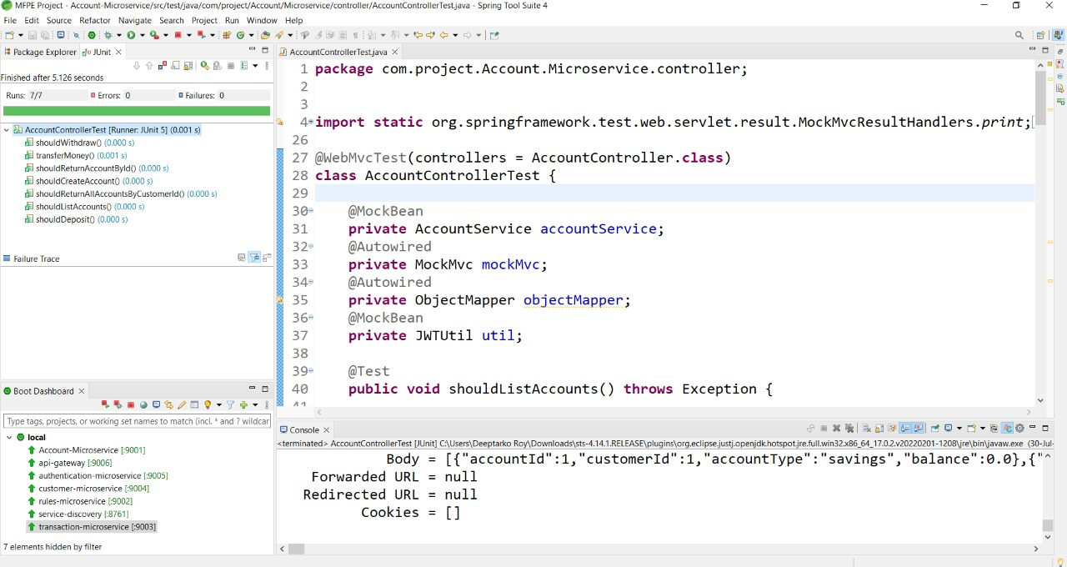
Unit testing and Code Coverage:

Slide 25
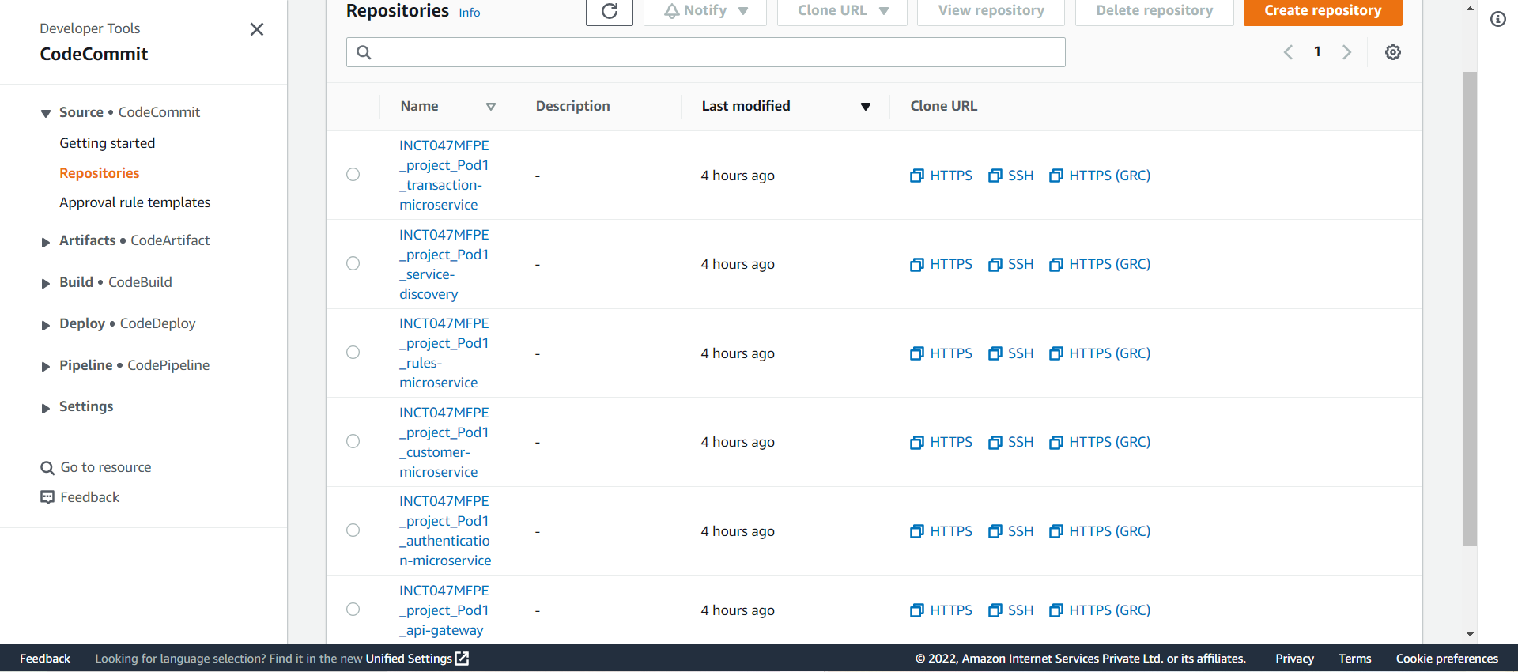
AWS Deployment
Code Commit :

Slide 26
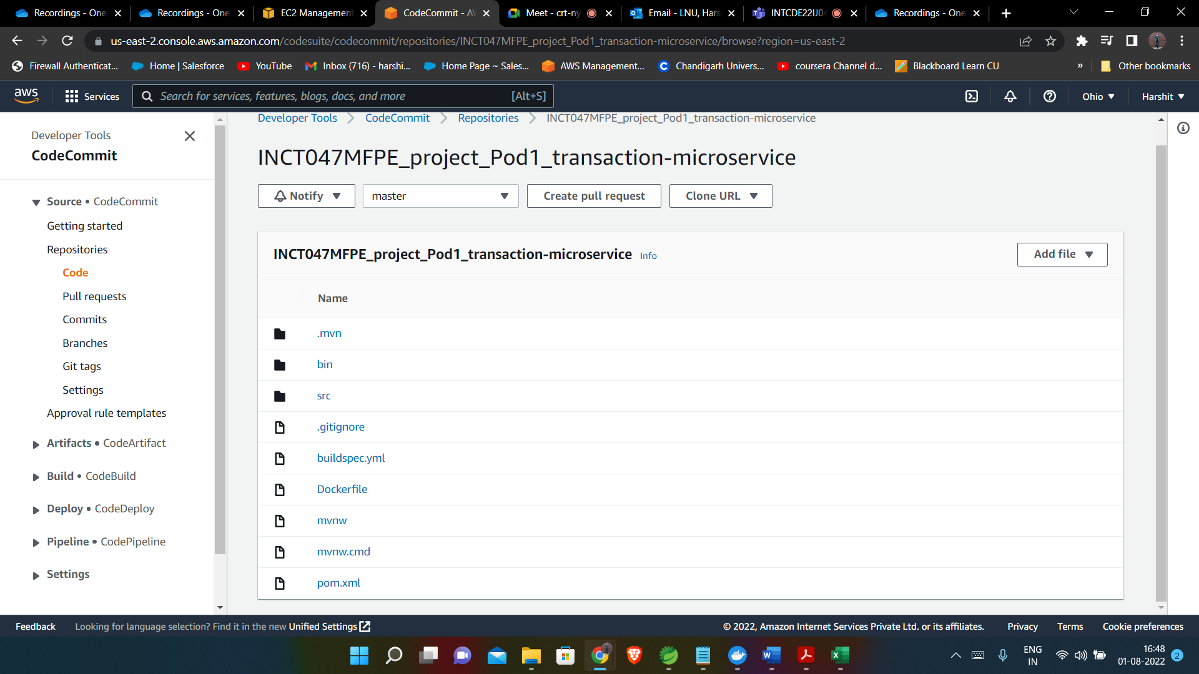

Slide 27
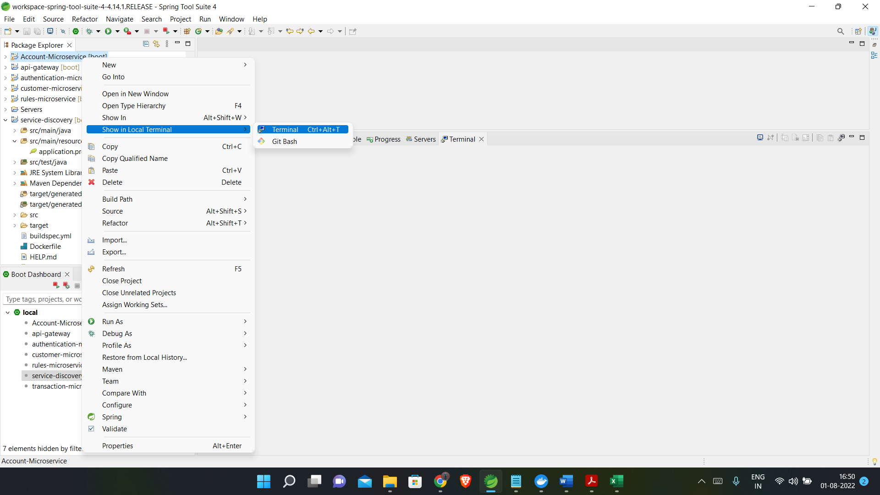
Pushing code in Code Commit

Slide 28
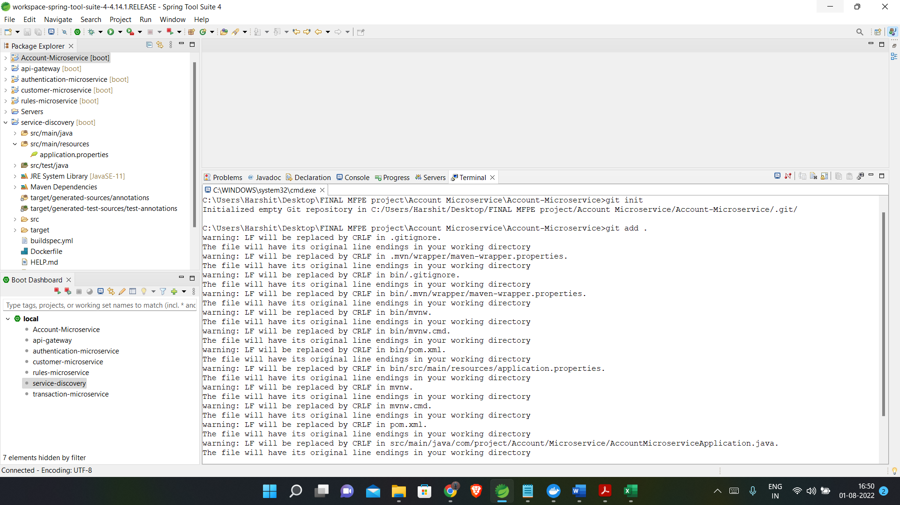
Pushing code in Code Commit

Slide 29
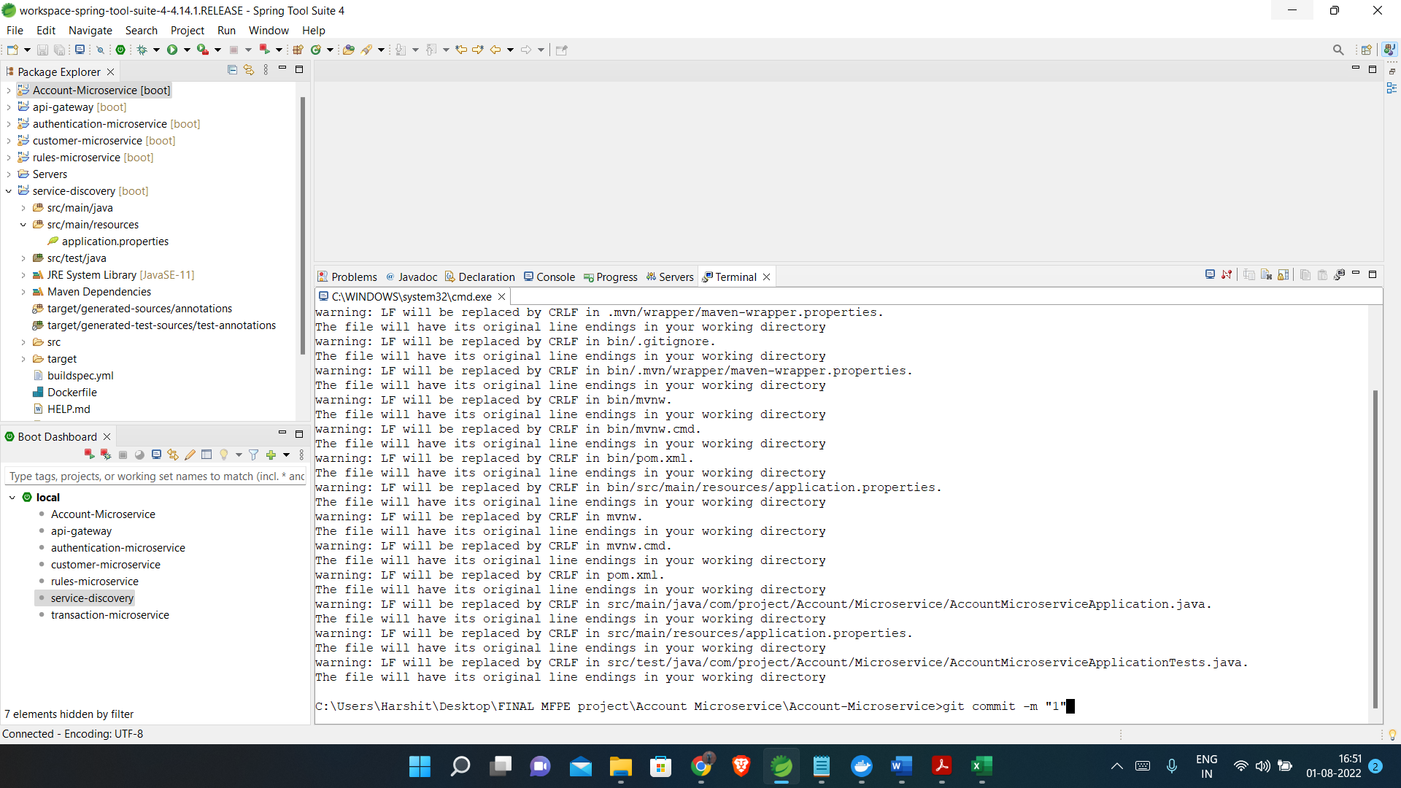
Pushing code in Code Commit

Slide 30
Pushing code in Code Commit

Slide 31
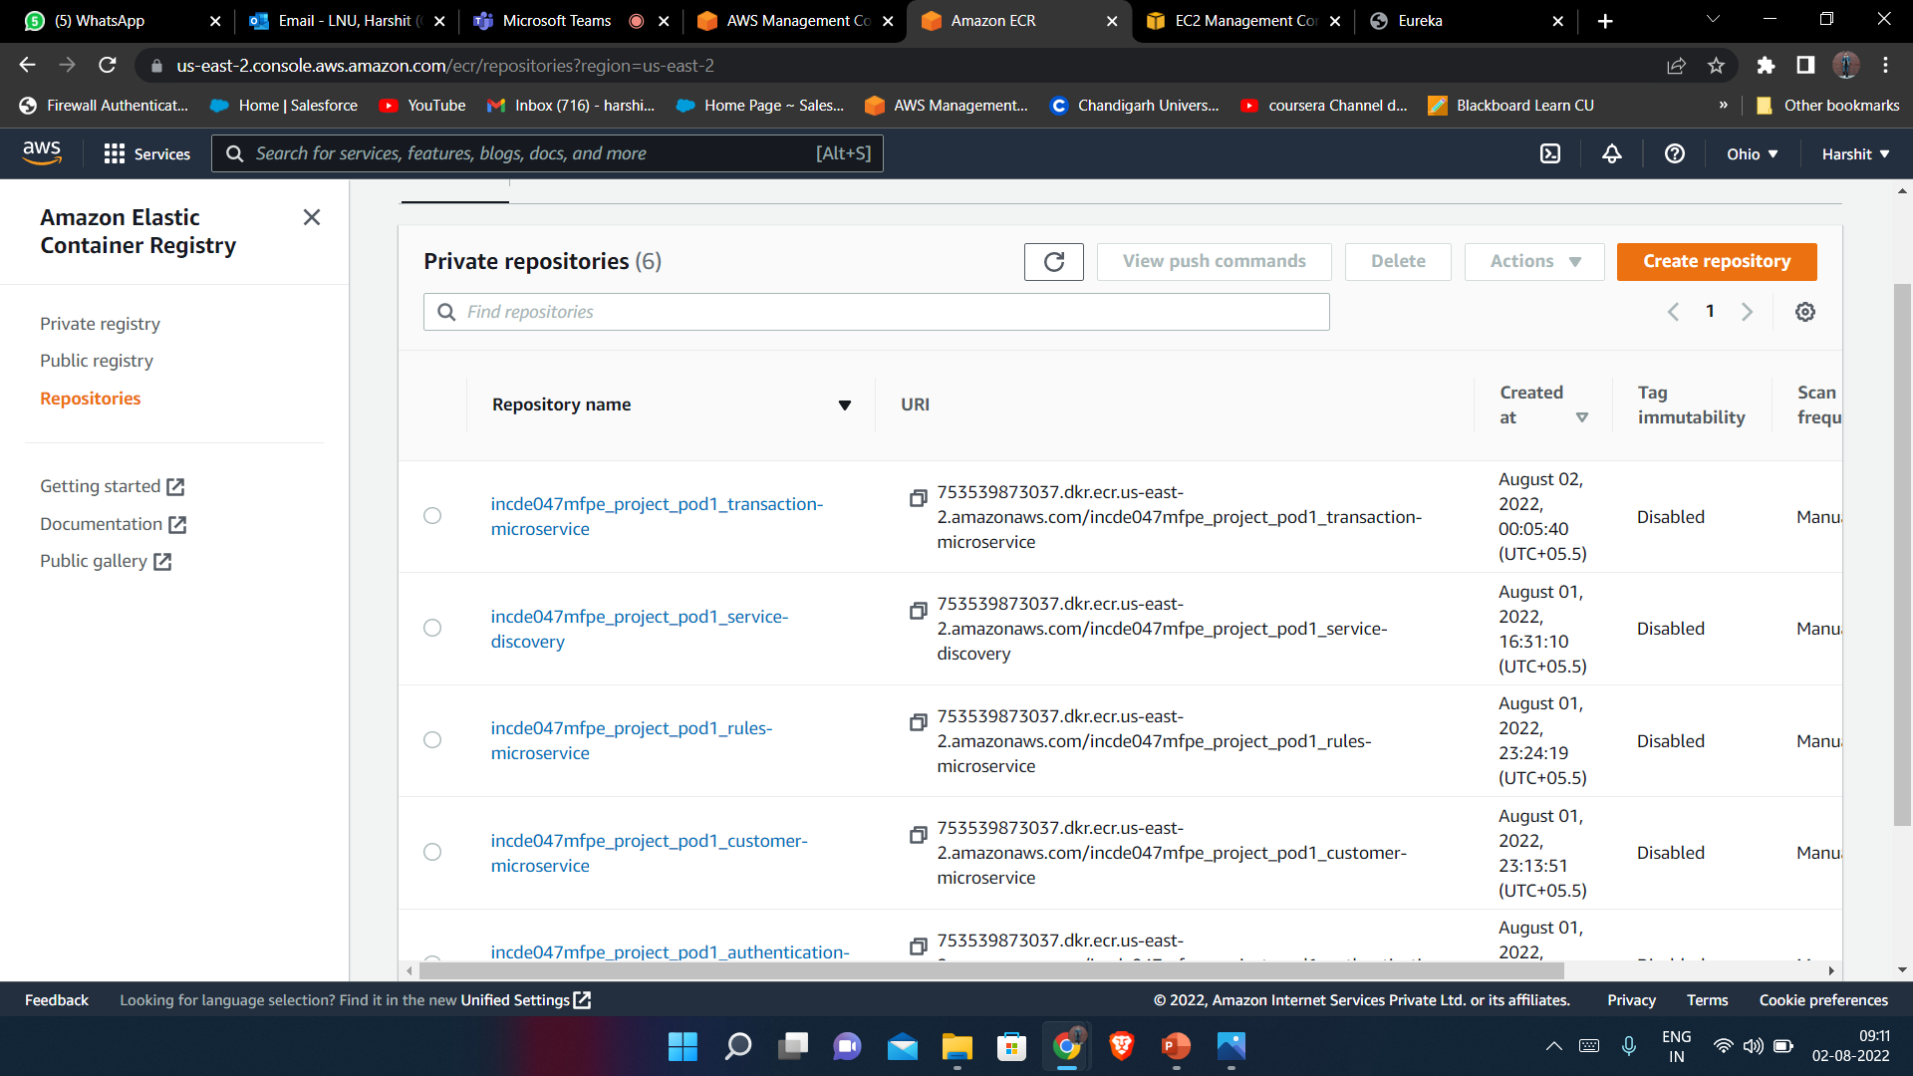
AWS Elastic container Registry

Slide 32
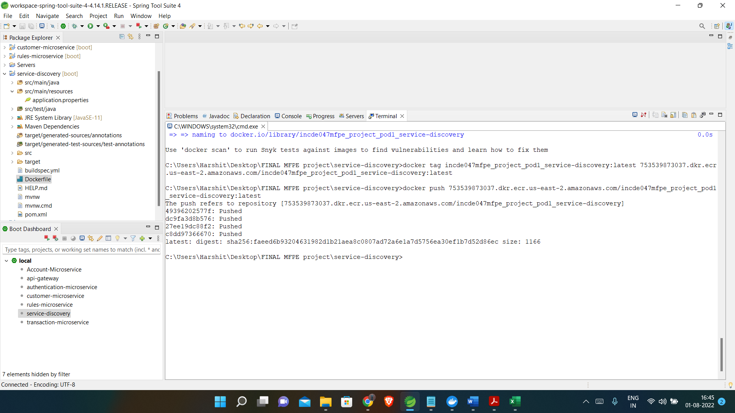
Dockerising Image

Slide 33
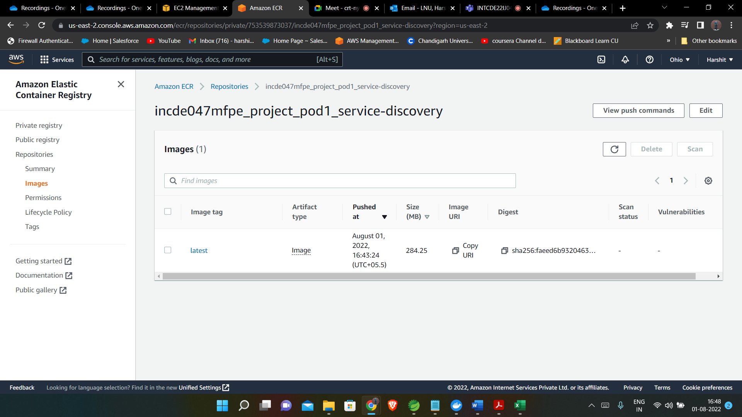
Docker Image in registry

Slide 34
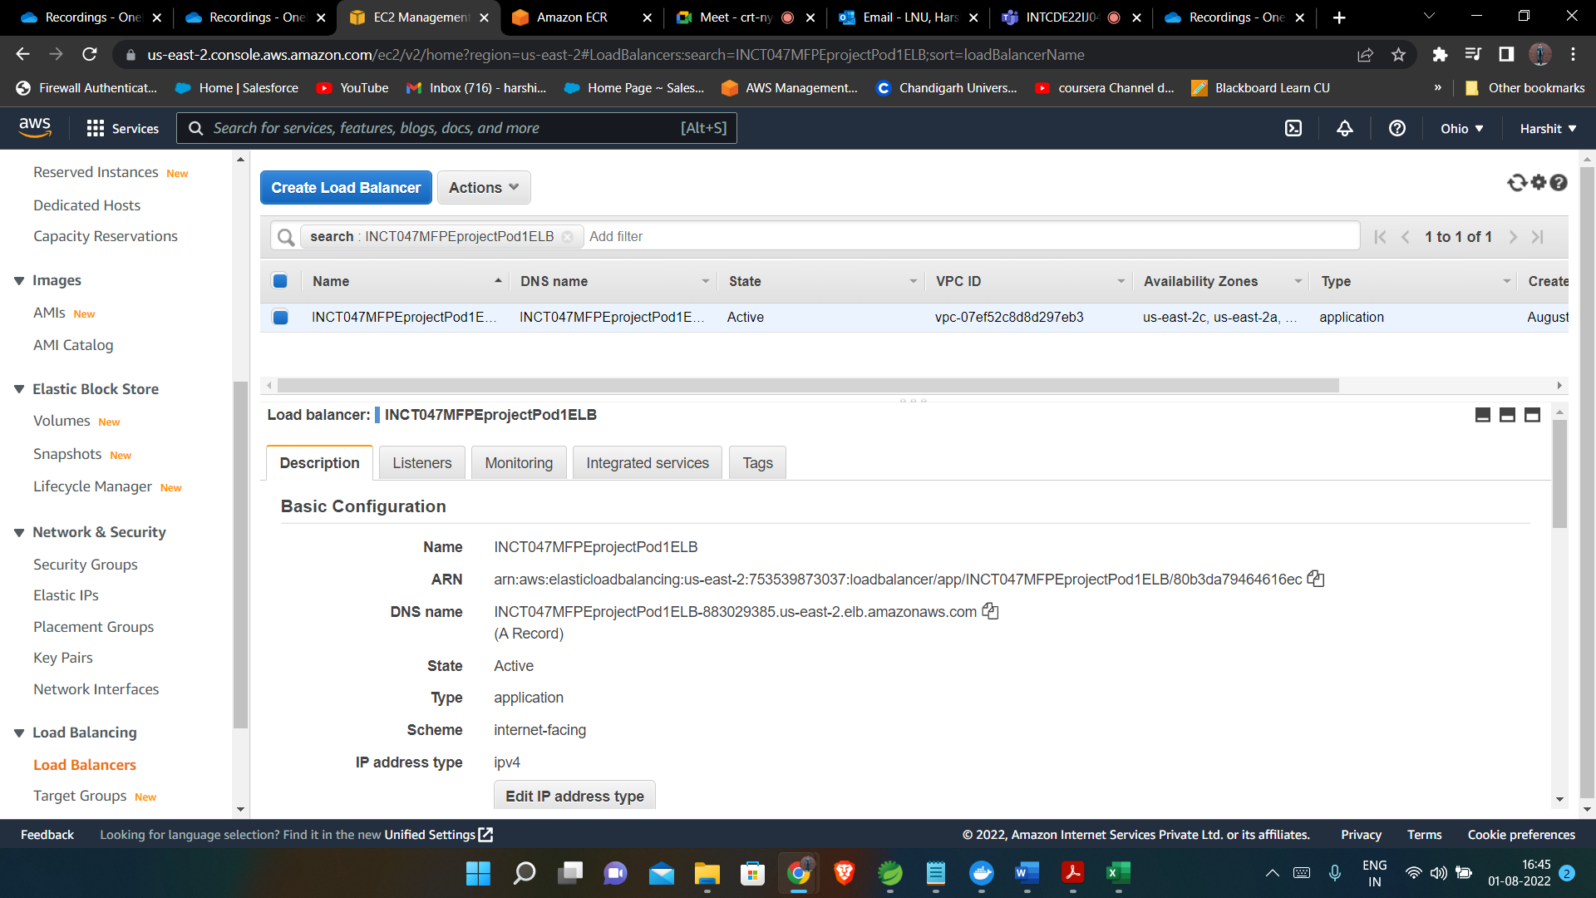
Creating ELB for deployment

Slide 35
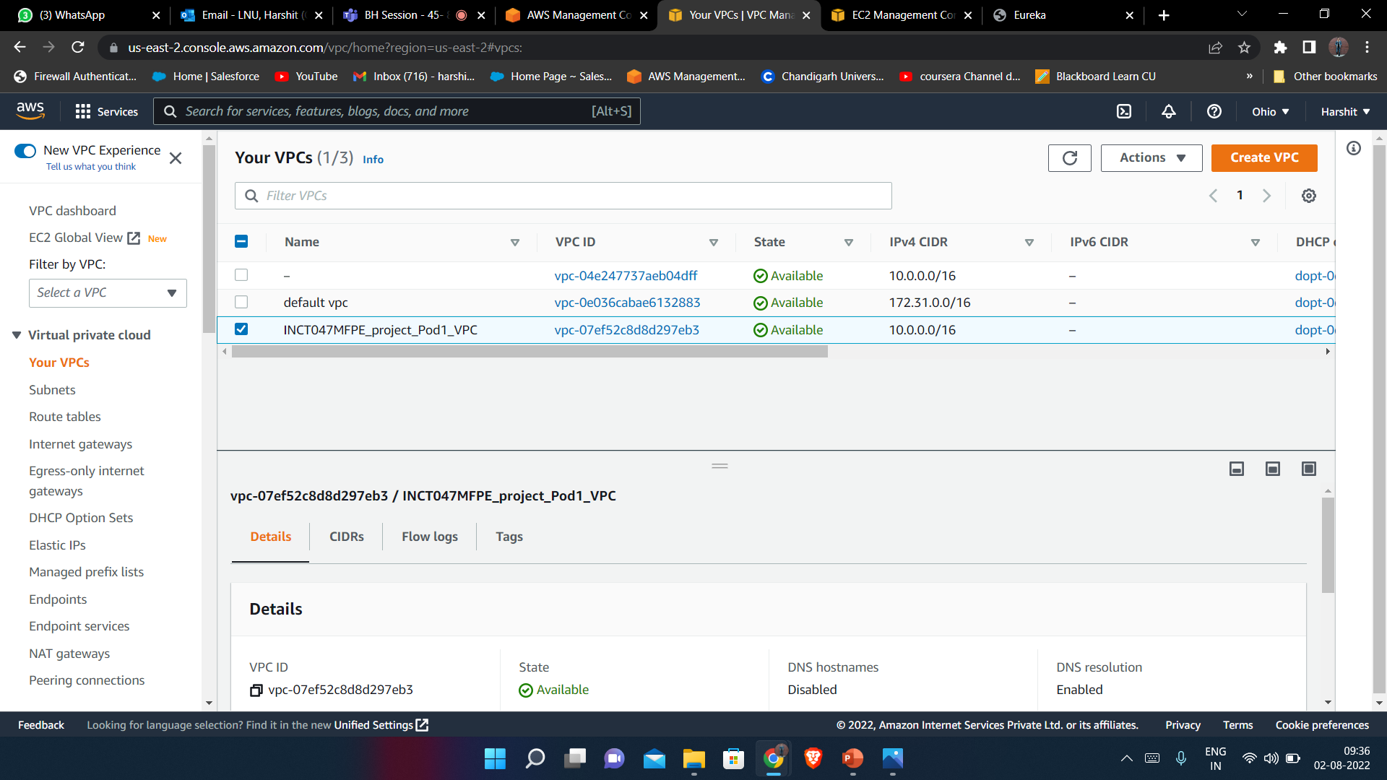
Creating VPC for deployment

Slide 36
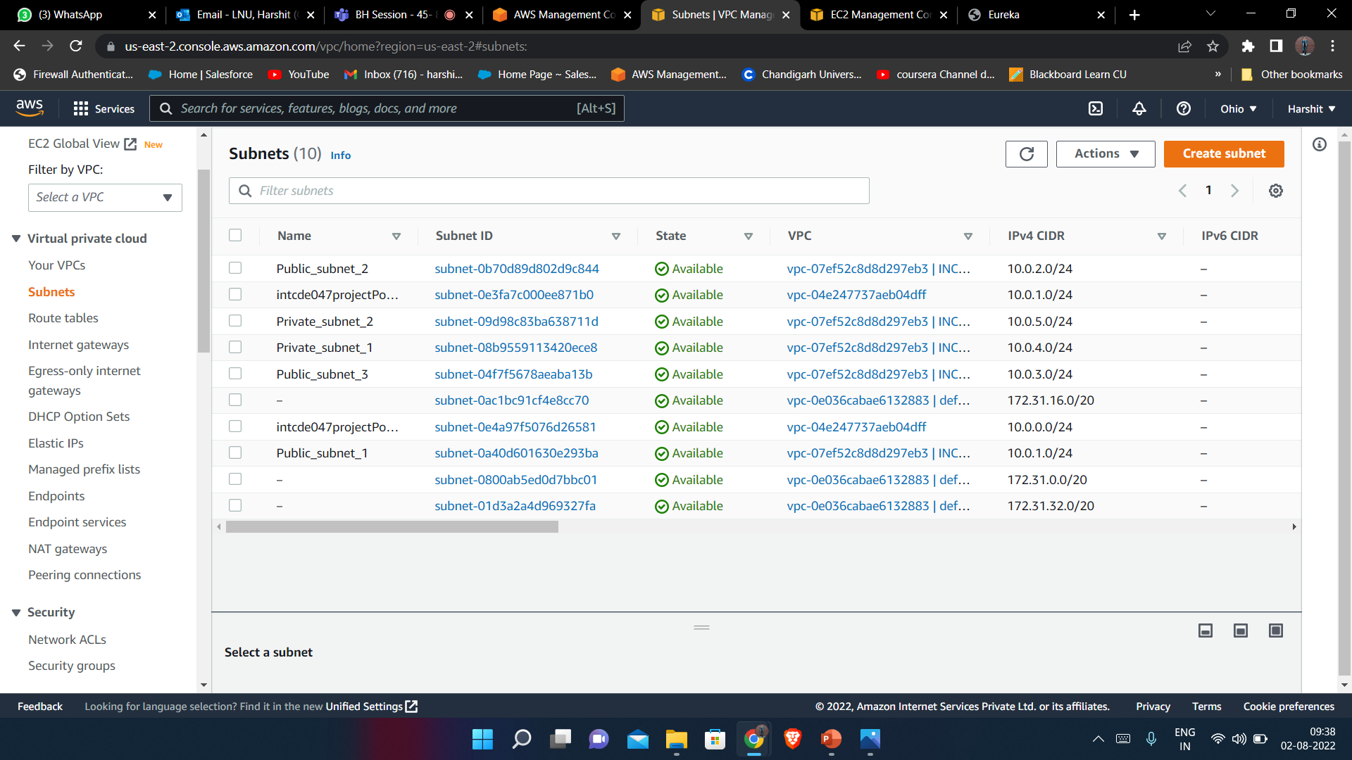
Creating Subnets inside VPC(public and private)

Slide 37
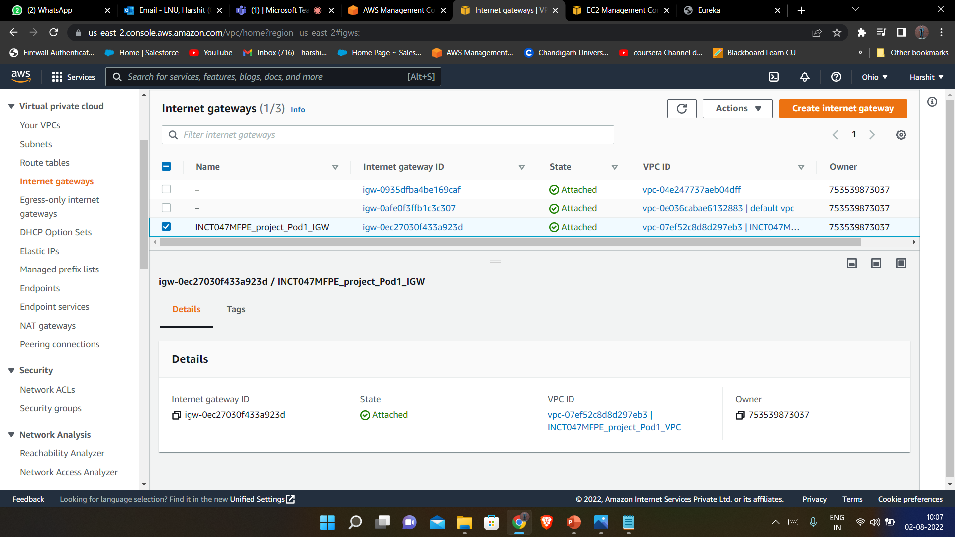
Creating Internet gateway inside VPC

Slide 38
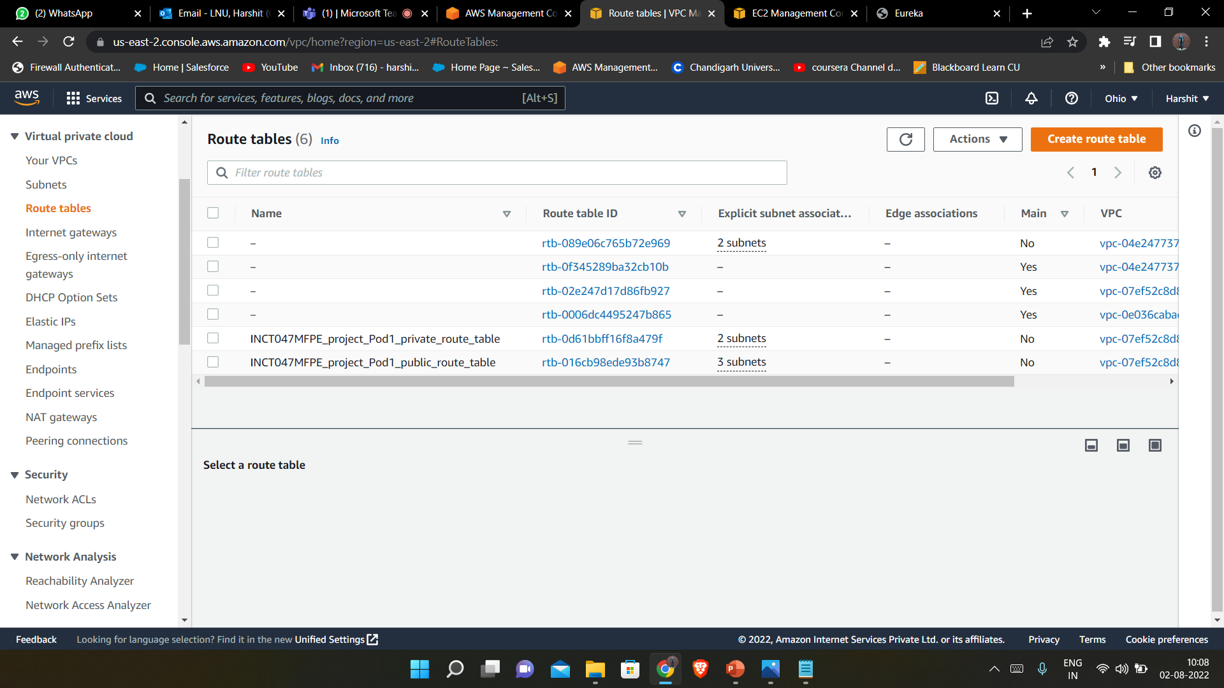
Creating route table inside VPC(public and private)

Slide 39
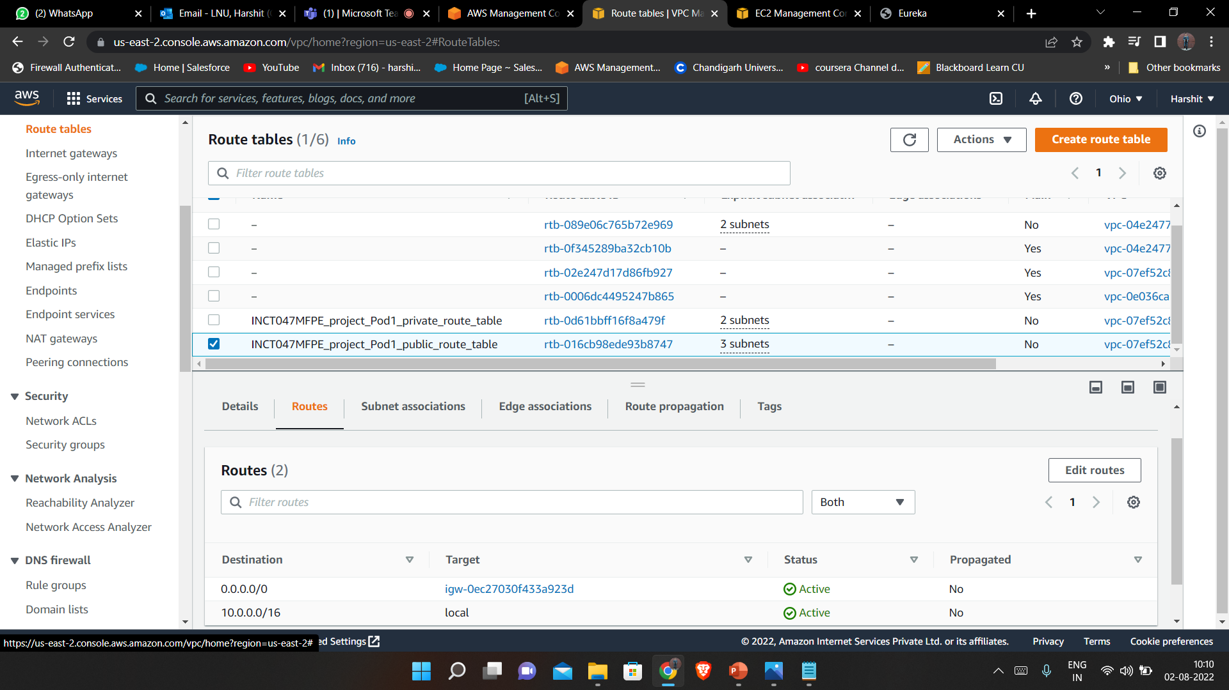
Attaching Internet Gateway to public route table

Slide 40
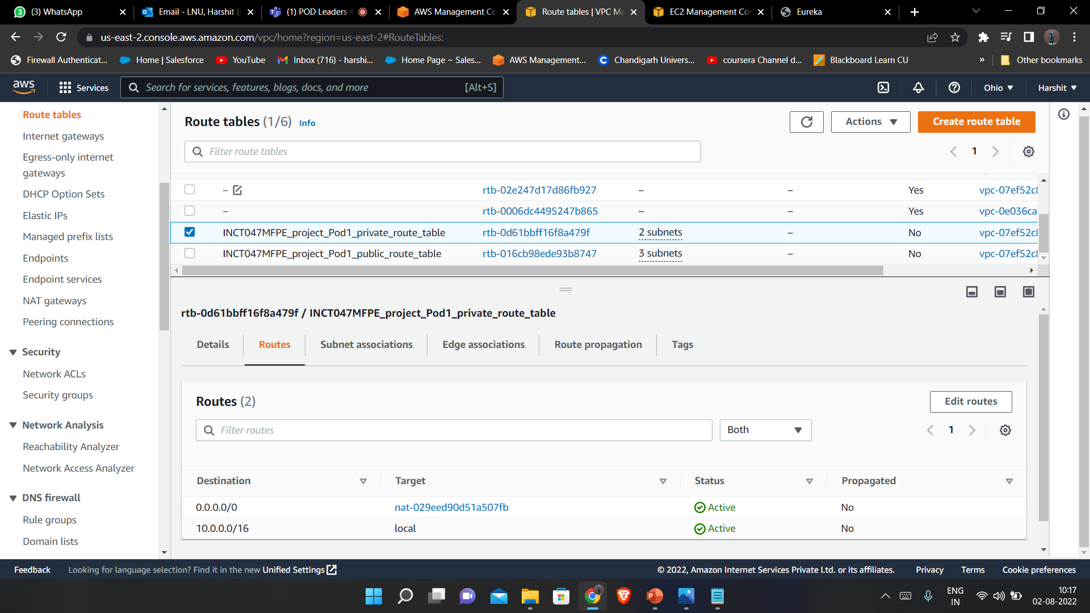
Attaching Nat Gateway to private route table

Slide 41
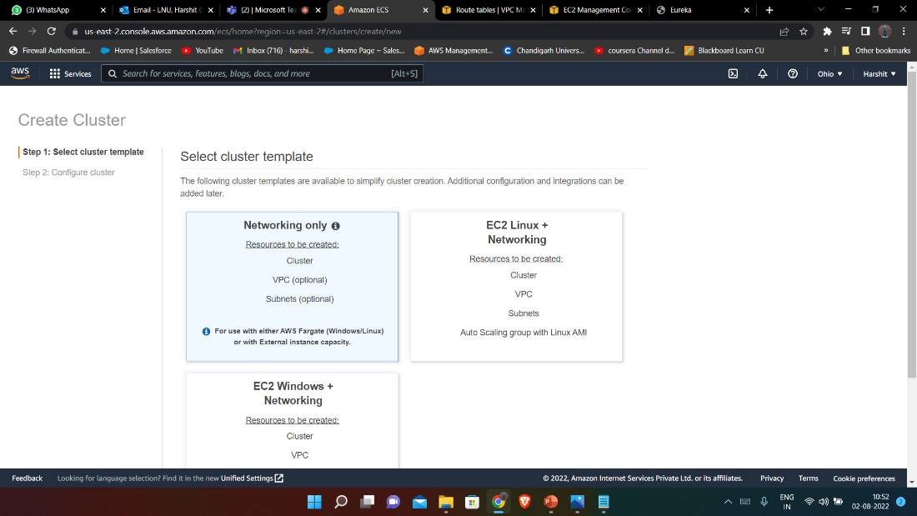
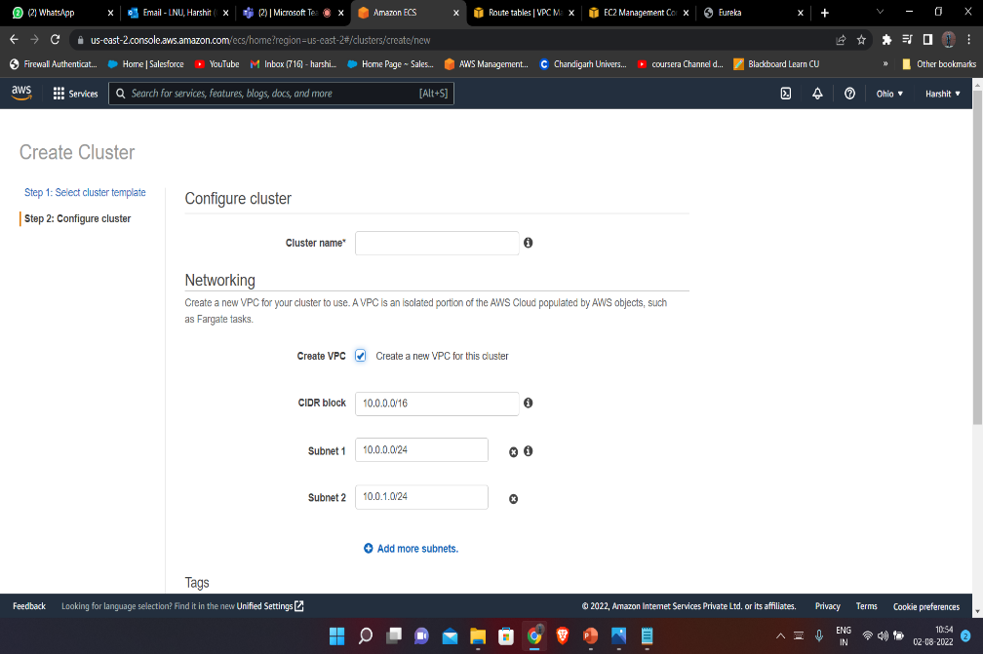
Creating a cluster inside ECS

Slide 42
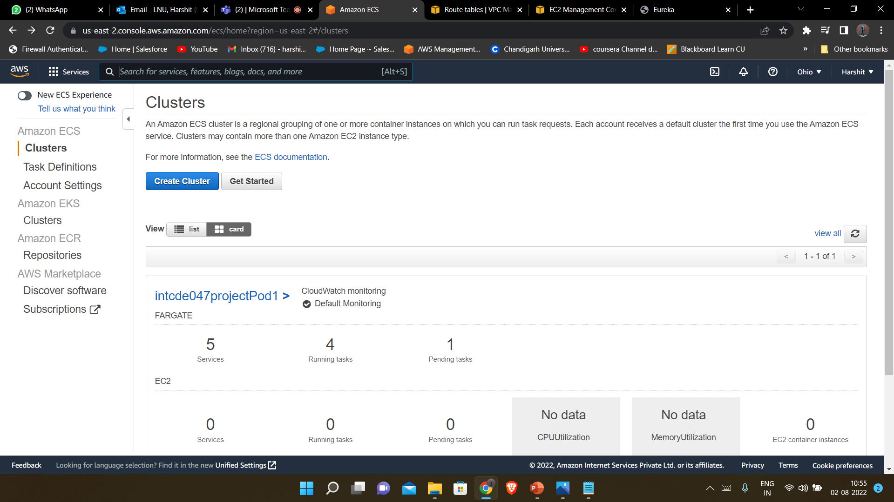
Creating a cluster inside ECS

Slide 43
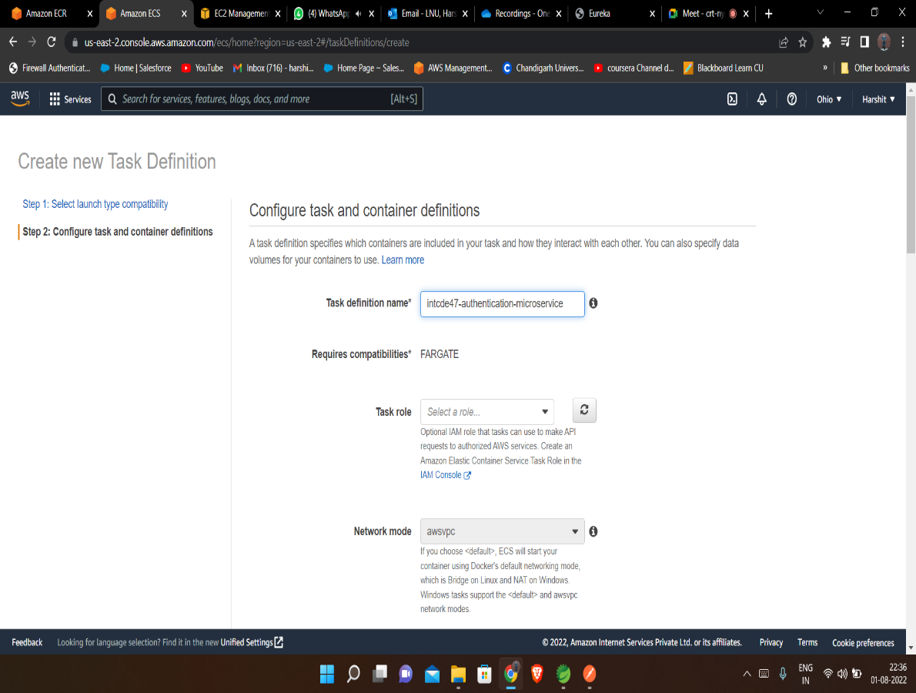
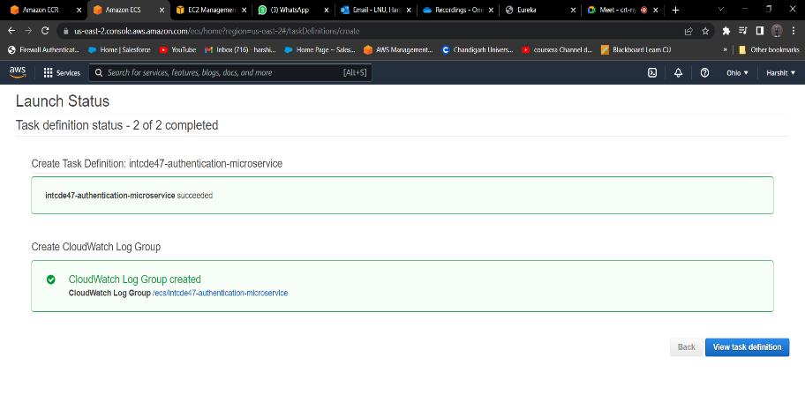
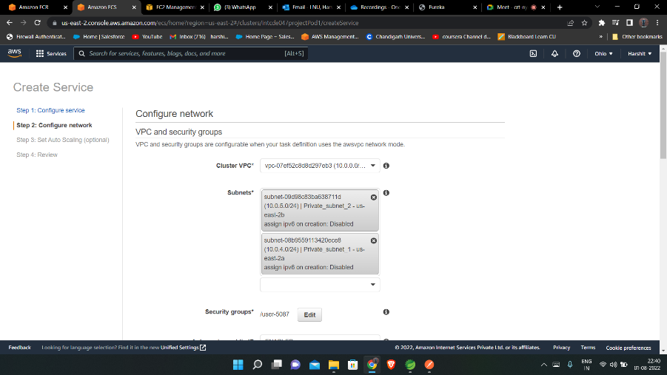
Creating a Multiple task definition inside ECS cluster

Slide 44
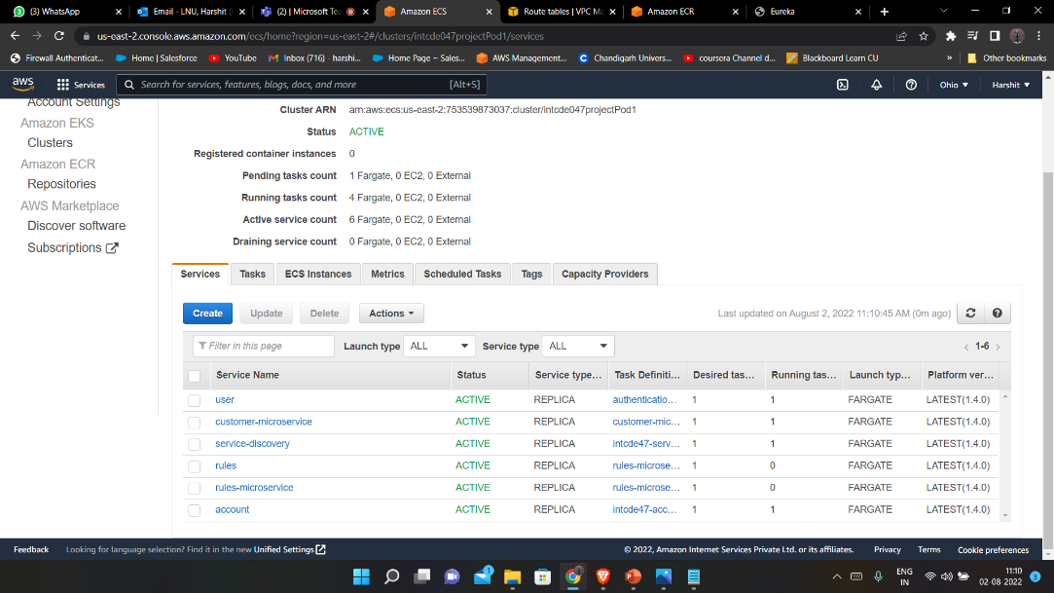
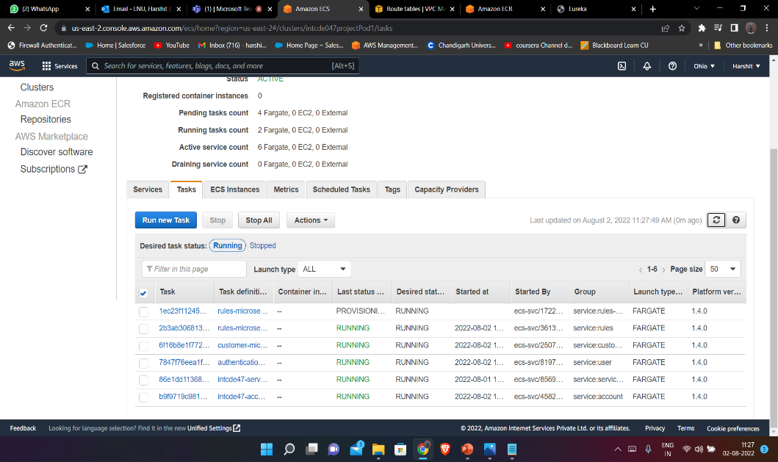
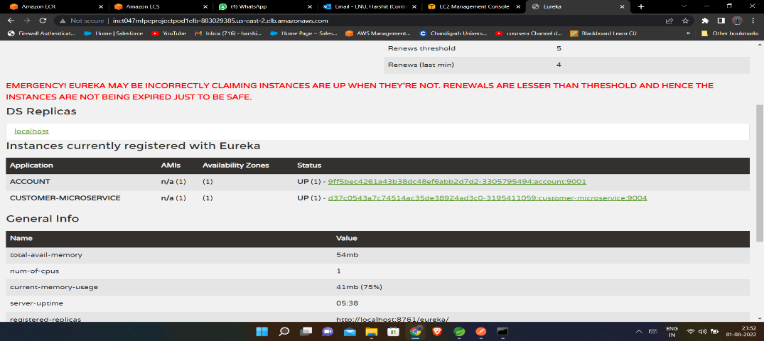
Create a services for each task definition

Slide 45
Thank You ..!

